Slide 1

Int-217
DATA SCIENCE PROJECT
ON
NIFTY INDICES ANALYSIS
Presented By :-
Name: Bhagesh J Khatri
Reg. No.: 11914224

Slide 2
Topics Covered
INTRODUCTION
SCOPE OF ANALYSIS
ANALYSIS OF DATASET
Monthly
Quarterly
Yearly
Volume Traded
Total Turnover
CONCLUSION

Slide 3
INTRODUCTION
The National Stock Exchange of India Limited (NSE) is the leading stock exchange of India, located in Mumbai. The NIFTY 50 index is National Stock Exchange of India's benchmark broad based stock market index for the Indian equity market.
Apart from NIFTY 50 index, there are also other indices like NIFTY Next 50, Nifty Midcap 150 etc. Exploring these indices may help in taking investment decisions.
This dataset has day level information on major NIFTY indices starting from 01 January 2000.
NIFTY 50, NIFTY 100 and NIFTY 500
NIFTY 500 - It represents the top 500 companies based on full market capitalisation from the eligible universe
NIFTY 100 - This represents the top 100 companies (i.e. from 1 to 100) from within the NIFTY 500. This index basically tries to track the performance of companies having large market caps.
NIFTY 50 - This represents the first 50 companies from the NIFTY 100.

Slide 4
Each file represents an index and has the following columns
Date - date of observation
Open - open value of the index on that day
High - highest value of the index on that day
Low - lowest value of the index on that day
Close - closing value of the index on that day
Volume - volume of transaction
Turnover - turn over
P/E - price to earnings ratio
P/B - price to book value
Div Yield - dividend yield

Slide 5
Scope of Analysis Our goal is to analysis Nifty Indices and to predict future trends for the NIFTY50 by analyzing the data of the 50 companies comprising the NIFTY50. This analysis will help us to: Taking better investment decisions in future Will help to predict the future of stock prices To identify factors affecting the share market If any news about a company is about to come and is it bad or good. Companies declare their performance results and profit at the end of each quarter.

Slide 6
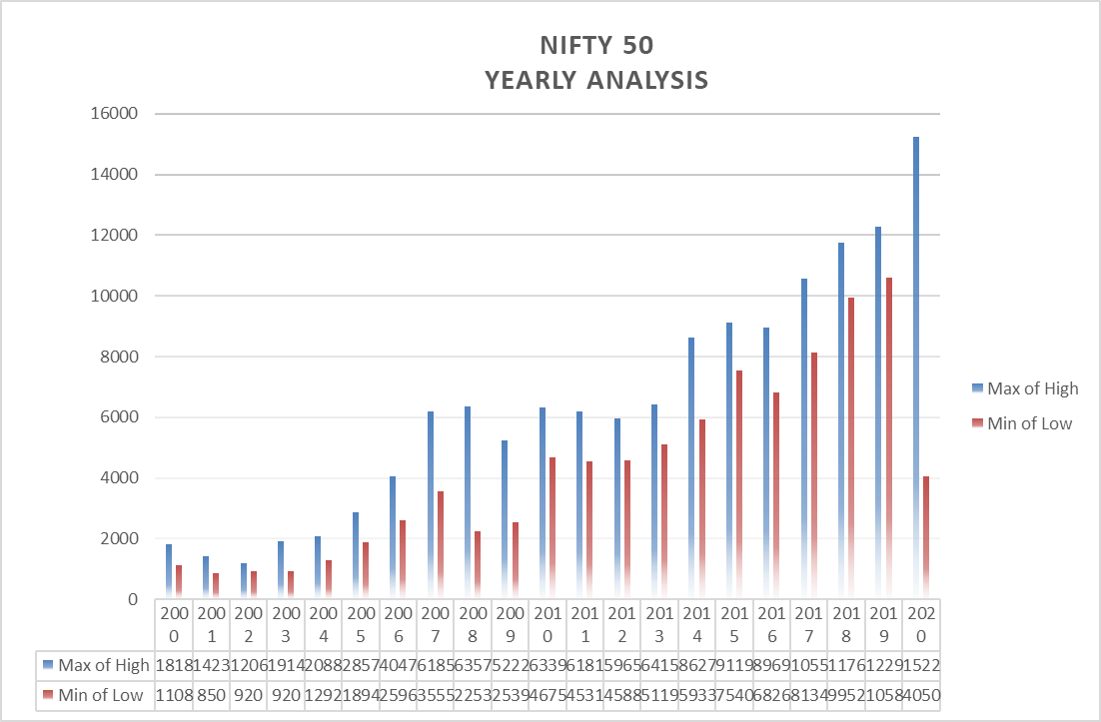

Slide 7
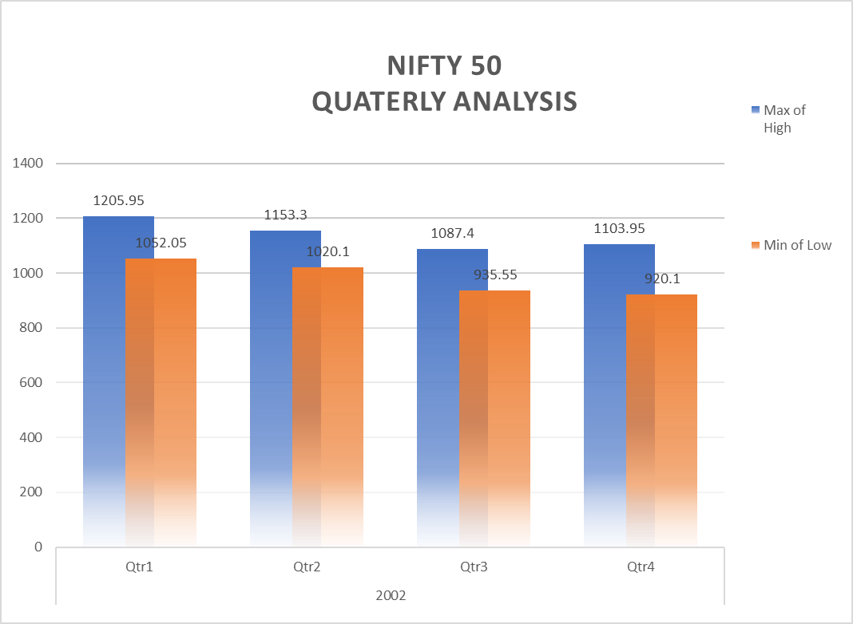

Slide 8
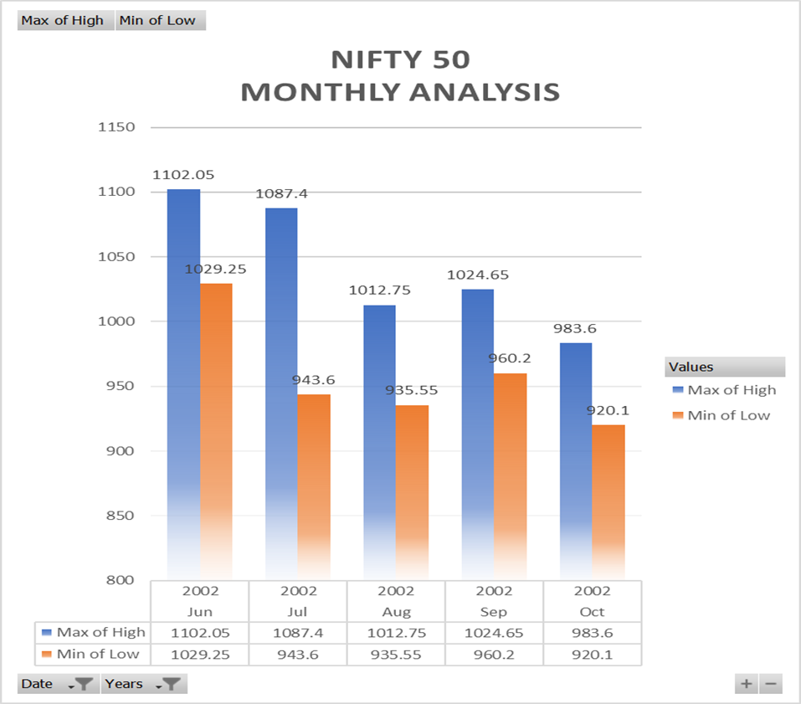

Slide 9
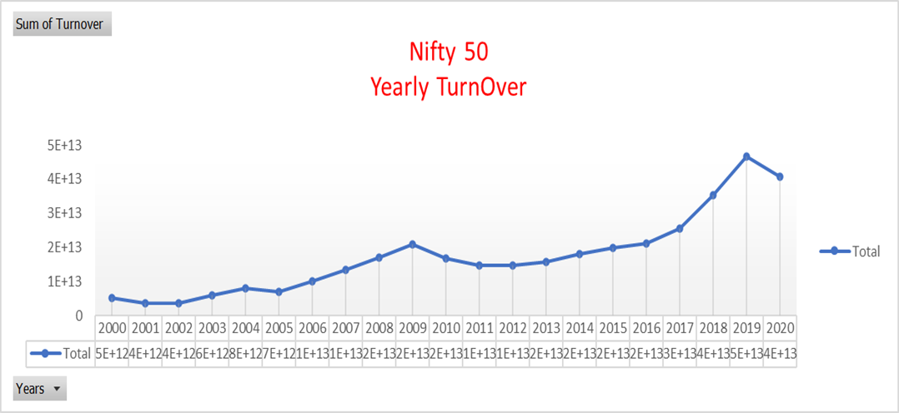

Slide 10
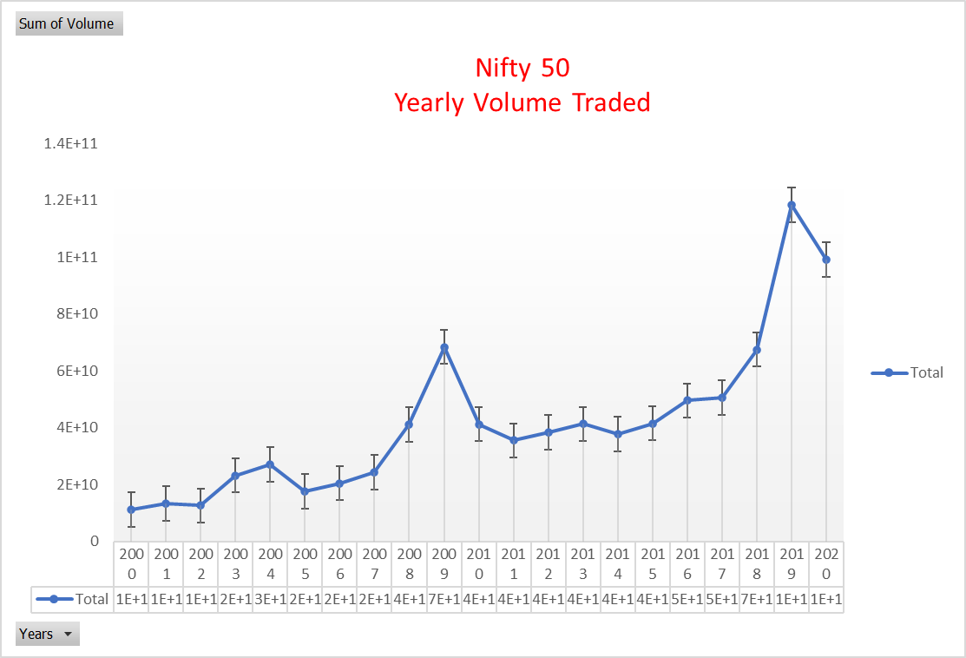

Slide 11
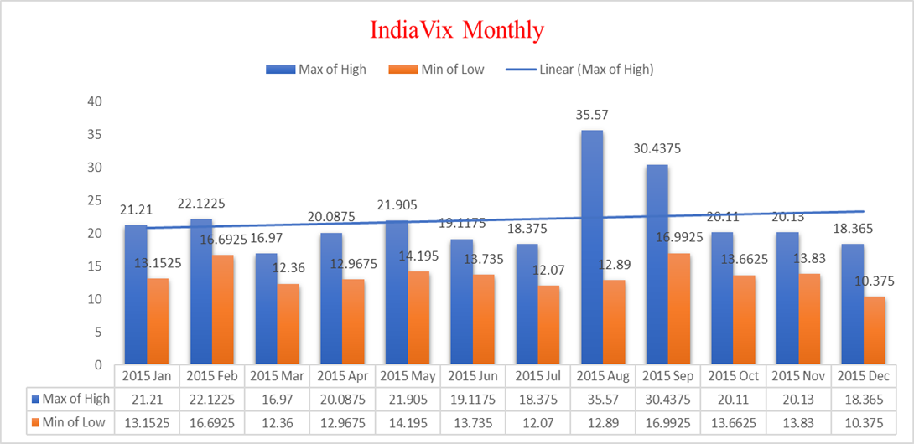

Slide 12
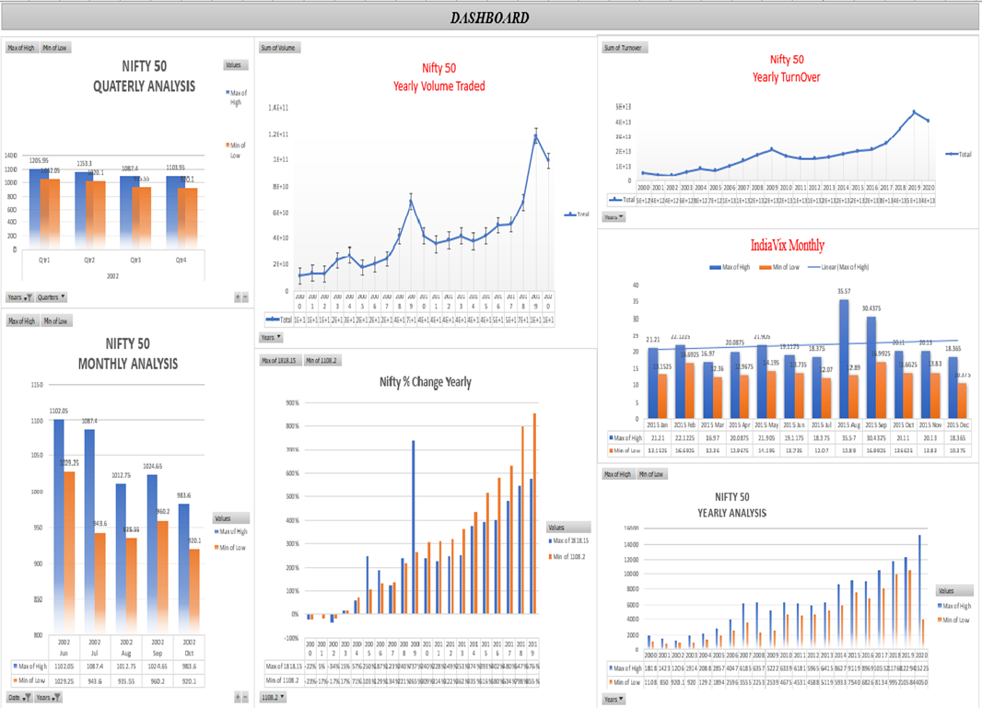

Slide 13
Conclusion
Based on the observations made in the data and analysing it year by year, month by month I feel like it may have been hit very hard due to the pandemic but it will soon rise above it when the environment gets stabilized.
In India the sentiments of people towards the stock market plays a huge importance on the graph.
Let's hope the pandemic period gets over soon.

Slide 14
THANK YOU

